Slide 1


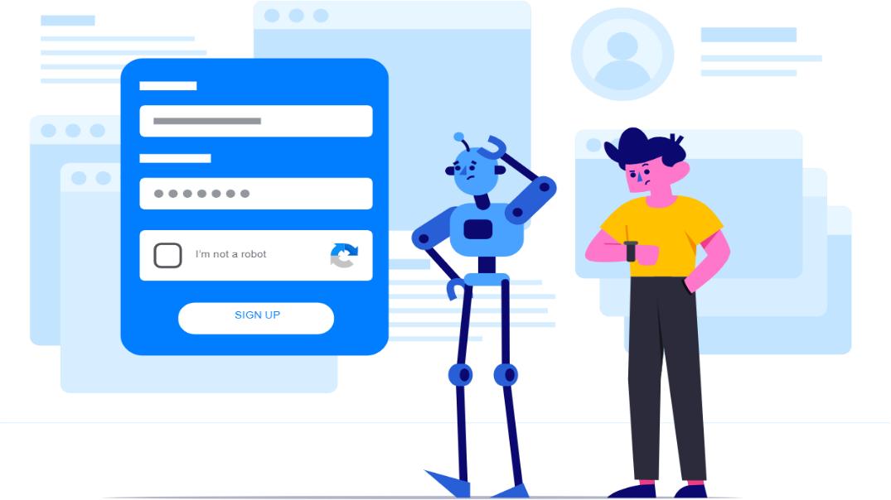
GNG 5125 Data Science Application Group Assignment
Psychological Chatbot
Group Six
Kun Qin Student Number: 300188345
Zhixin He Student Number: 300142825
Wenqi Lin Student Number: 300201446
Yuxue Pang Student Number: 300177911

Slide 2


Machine guard mental health!
Psychological problems in reality
Impact of the COVID-19 Don't know where and who can help
Increasing pressure No response when needed
Psychological Chatbot
Professional psychology knowledge
Providing service whenever you need it
Simple operation page
The recommendation system considers your needs

Slide 3




2. Answer
User input question
The model classifies the question
Output the corresponding question
1. Model
Prepare data
Use data to train the model
4. Feedback
User clicks on question links
Return the answer to users
3. Recommend
Confusion matrix find similar problems
Recommend related questions to Unser

Slide 4

Content
1
2
Data
Algorithm
Preparation Process Transform
Classification Clustering
3
4
Analysis
Innovation
Accuracy Confusion Matrix
Platform Recommended system

Slide 5
Data
Preparation
Download dataset form website Kaggle
98 professional questions with answers
01
Enrich
Adding 4 other questions for original questions
Each group get 5 questions and 1 answer
04
02
Clean
Clean up stop words and punctuation in the problem
Clean up special characters in answers
03
Transform
Bag of words
Term frequency–inverse document frequency
https://www.kaggle.com/narendrageek/mental-health-faq-for-chatbot

Slide 6





Classification
Algorithm | BOW | TF-IDF
SVM | 0.79 | 0.83
KNN | 0.73 | 0.75
DC | 0.75 | 0.71
SVM + BOW
svm.SVC(C=0.5, kernel='linear', decision_function_shape='ovo')
SVM + TF-IDF
svm.SVC(kernel='linear', C=1)
KNN + BOW
KNeighborsClassifier(n_neighbors=1,algorithm='kd_tree',weights = 'distance')
KNN + TF-IDF
KNeighborsClassifier(n_neighbors=2,algorithm='auto',weights = 'distance', p = 3)
DC + BOW
tree.DecisionTreeClassifier(splitter='best', criterion = 'gini')
DC + TF-IDF
tree.DecisionTreeClassifier(splitter='best')

Slide 7



Clustering
Algorithm |  | Kappa | Consistency | silScore | chScore
K-Means | BOW | 0.041237 | 0.182656 | 0.066978 | 3.206853
 | TF-IDF | 0.041237 | 0.249760 | 0.030693 | 3.953466
GM | BOW | 0.041237 | 0.284635 | 0.066765 | 3.178924
 | TF-IDF | 0.041237 | 0.270914 | 0.029805 | 5.206064
HC | BOW | 0.047423 | 0.306309 | 0.017640 | 2.590824
 | TF-IDF | 0.051546 | 0.276610 | 0.052813 | 3.191267
K-Means
kmeans = KMeans(n_clusters = 5, init='k-means++', n_init=10, max_iter=400,
tol=0.0001, precompute_distances=True, verbose=0, random_state=9,
copy_x=True, n_jobs=None, algorithm='elkan')
GM
gmm = GaussianMixture(n_components=5, covariance_type='full', tol=0.0001, reg_covar=1e-06, max_iter=300, n_init=200,weights_init=None, means_init=None, precisions_init=None, random_state=None, warm_start=False,
verbose=0, verbose_interval=10)
HC
ac = AgglomerativeClustering(n_clusters=5, affinity='euclidean', linkage='ward')

Slide 8
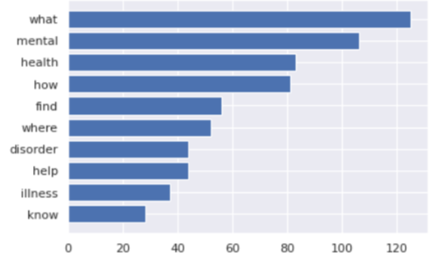
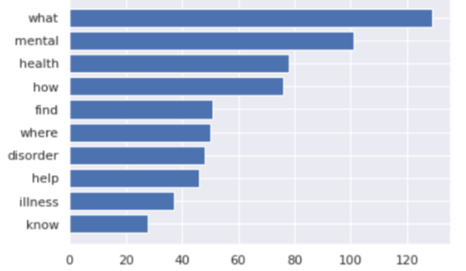
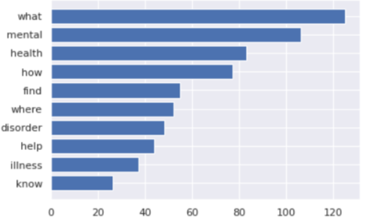
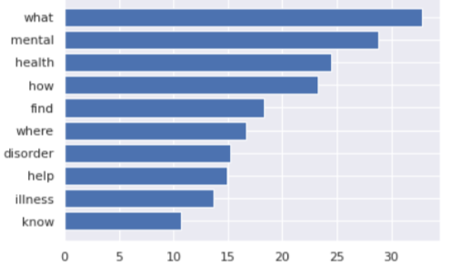
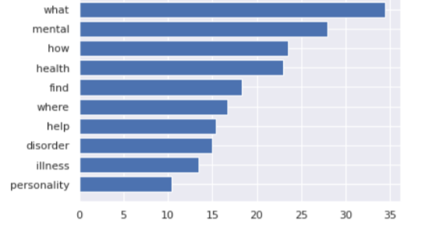
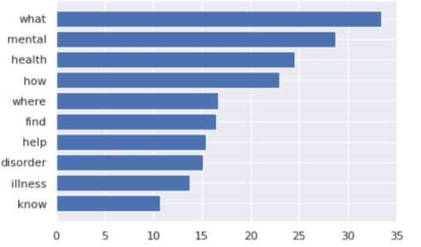
Analysis
Frequency Words through BOW
KMeans
EM
HC
Frequency Words through TD-IDF

Slide 9
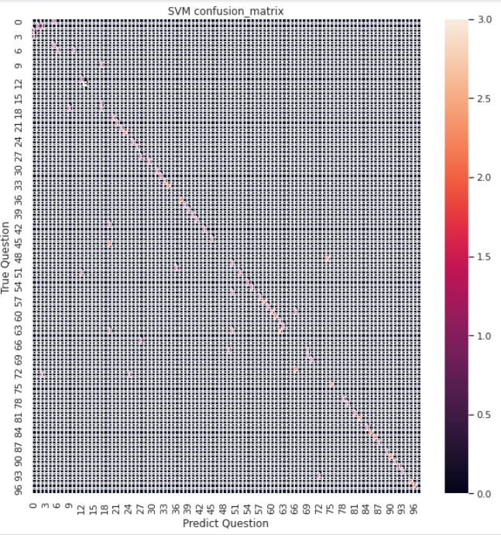
Analysis
TF-IDF + SVM
The machine has some problems in distinguishing between 66 to 72 and 12 to 24, which means that these problem groups may be somewhat similar to other problems.
The distribution of the model looks like a diagonal line from the upper left corner to the lower right corner.
The model we design has good accuracy most of the time.

Slide 10
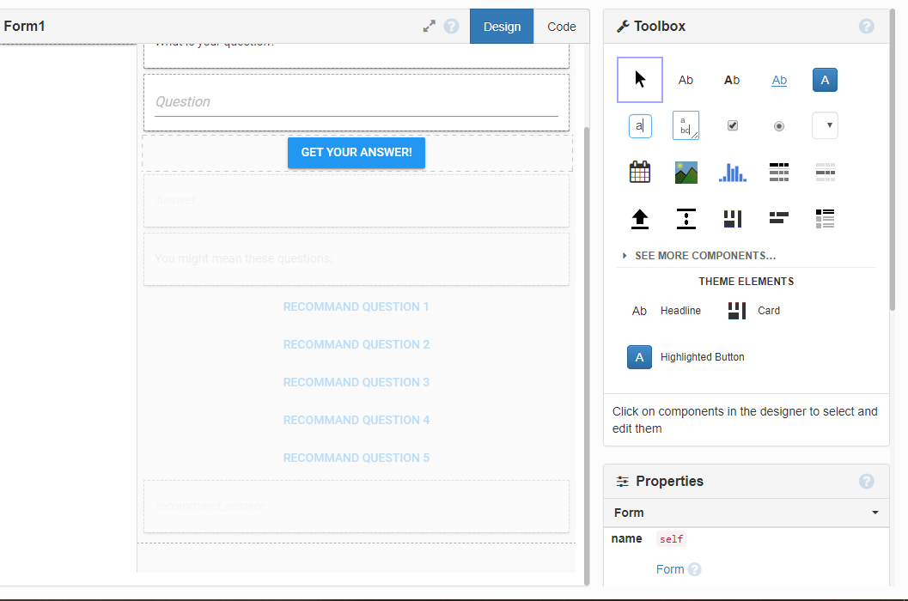
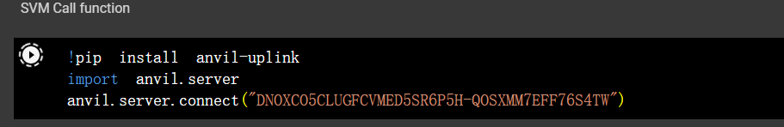
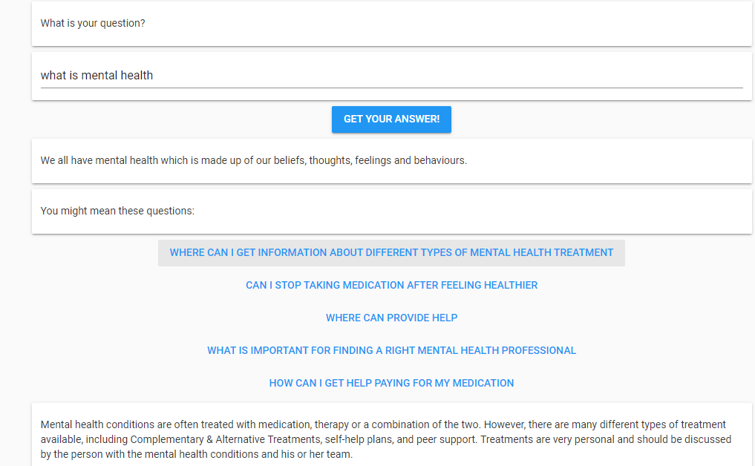
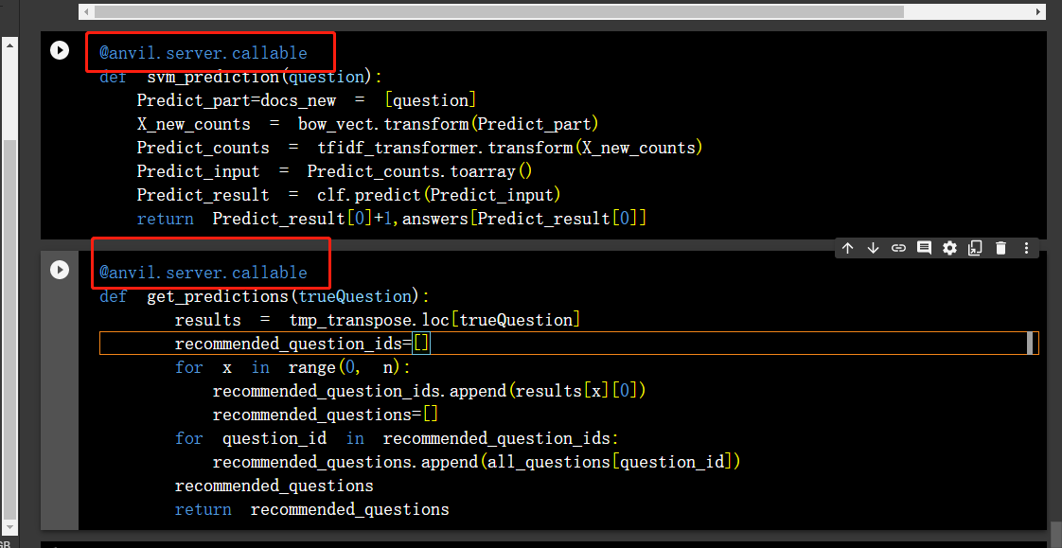
Innovation
Our group used the anvil online platform to realize the GUI development. Anvil is a platform that can be connect with google colab to do amazing front end display.
Design Page
Connect Colab
Final display

Slide 11
Innovation
When customers ask questions, we will also recommend similar questions.
We obtain similar problems through confusion matrix.
Train model
User input
Get answer
Use data to train the model.
Five similar questions obtained by confusion matrix.
The user enters the question.
The system searches and recommends five similar questions.
The page gets and displays the recommended results.
The user clicks on the recommended question.
The front end returns the answer to the question.

Slide 12

Thank you for listening!
G
G
g
Waiting for questions!
G
G
g

